Slide 1
UNIT III

Slide 2
Unit 3: Syntactic Analysis
Context-Free Grammars, Grammar rules for English, Treebanks, Normal Forms for grammar
– Dependency Grammar – Syntactic Parsing, Ambiguity, Dynamic Programming parsing – Shallow parsing –Feature structures, Unification of feature structures.

Slide 3
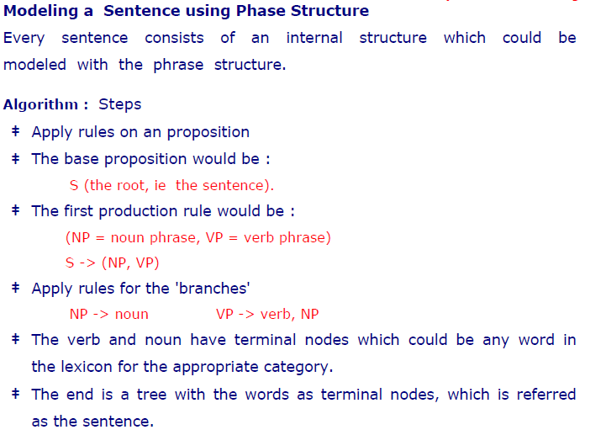

Slide 4
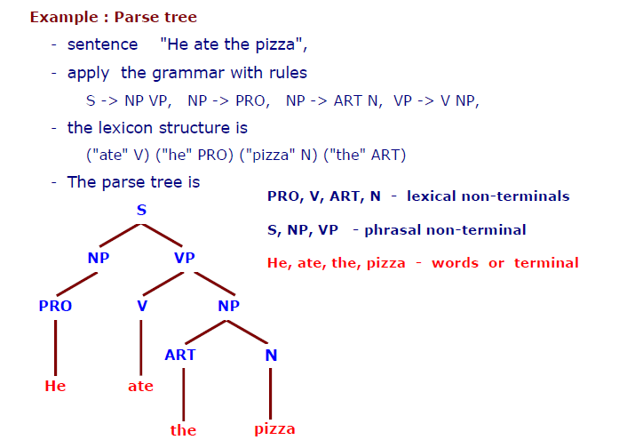

Slide 5
S → NP VP
NP → Det N
VP → V NP
Det → "the" | "a"
N → "cat" | "dog"
V → "chased" | "saw“
Example Sentence Generation
"The cat chased a dog"
"A dog saw the cat"

Slide 6
S → NP VP
NP → Det N | NP PP
VP → V NP | VP PP
PP → P NP
Det → "the" | "a"
N → "boy" | "girl" | "dog"
V → "sees" | "likes"
P → "with" | "on"
Example Sentences "The boy sees a dog"
"A girl likes the boy with the dog"

Slide 7
S → NP VP | Aux NP VP
NP → Det N | Pronoun
VP → V NP | V NP PP
PP → P NP
Aux → "does"
Det → "the" | "a"
N → "man" | "book"
V → "read"
P → "in"
Pronoun → "he" | "she“
Example
"He reads a book"
"Does the man read a book?"
"She reads the book in the library"

Slide 8
S → NP VP
NP → NP Conj NP | Det N
VP → V NP
Conj → "and" | "or"
Det → "the" | "a"
N → "cat" | "dog"
V → "chases" | "sees“
Example Sentences
"The cat and the dog chase a ball"
"A dog or a cat sees the man"

Slide 9
Applications of CFG in NLP:
Parsing and Syntax Analysis: Used in natural language parsers.
Speech Recognition: Helps in structuring spoken phrases.
Machine Translation: Defines grammatical structures across languages.
Chatbots & AI Assistants: Helps in generating syntactically correct responses.

Slide 10
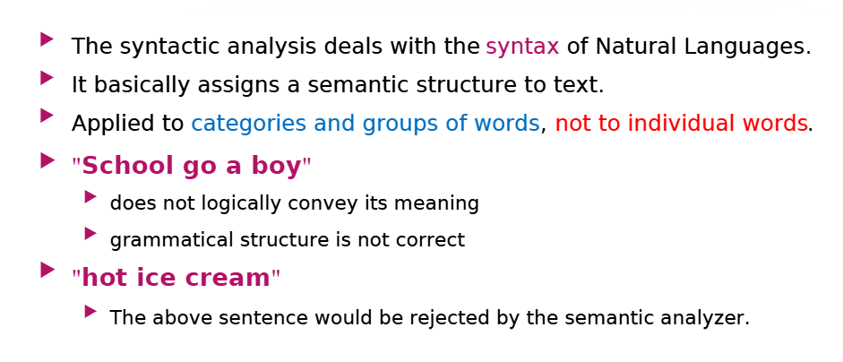
Syntax analysis or syntax parsing

Slide 11
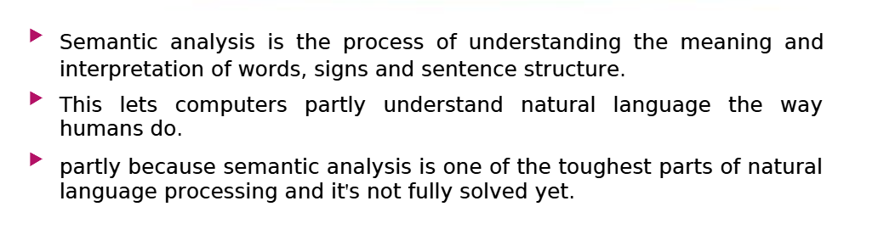
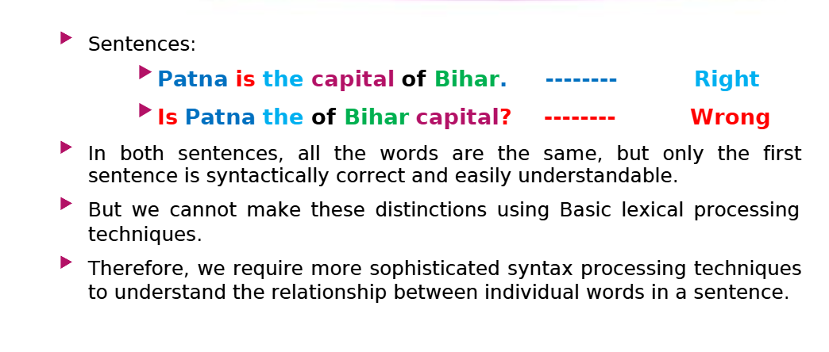

Slide 12
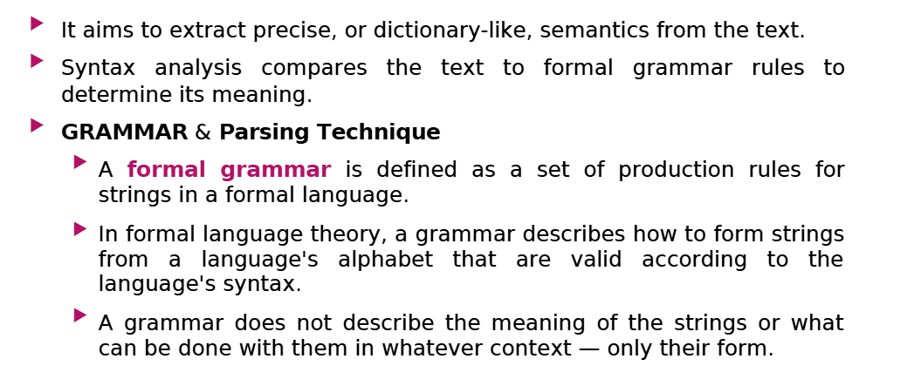

Slide 13
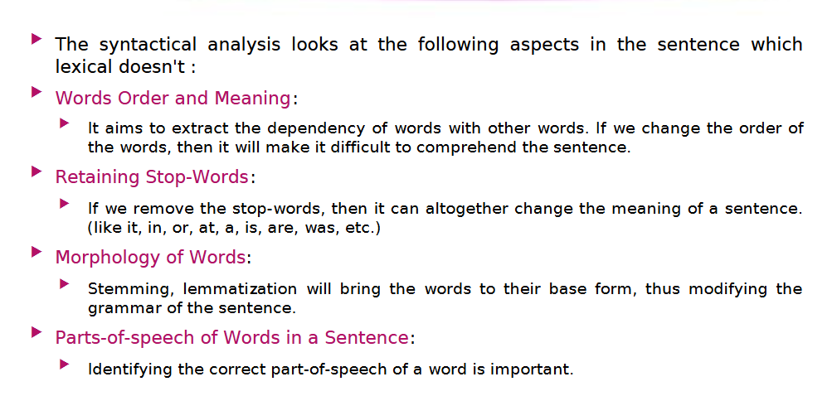

Slide 14
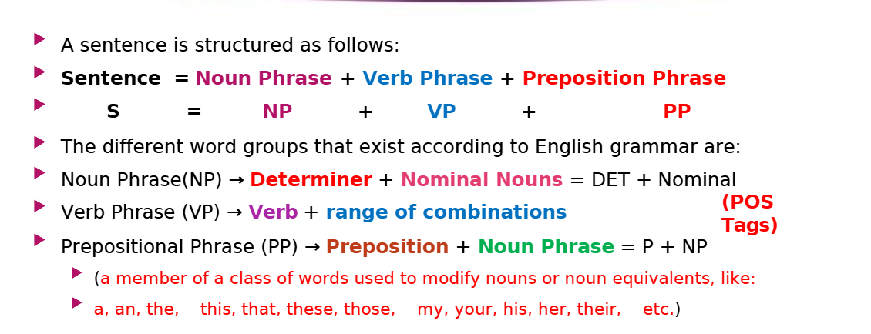
How are words arranged

Slide 15
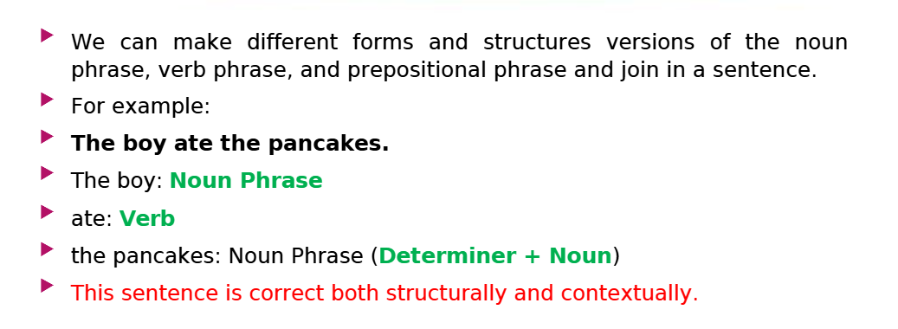
Example 1

Slide 16
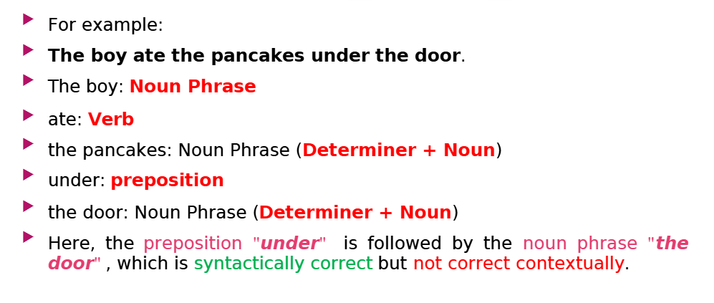
Example 2

Slide 17
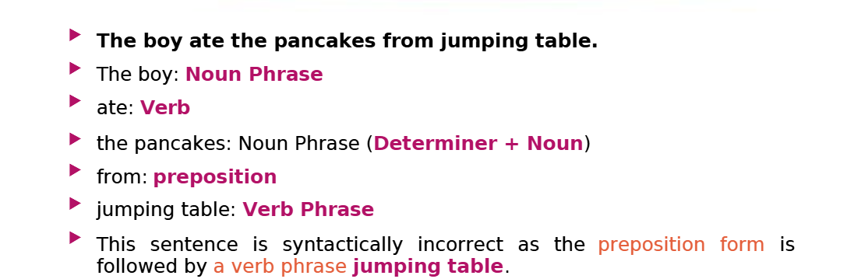
Example 2

Slide 18
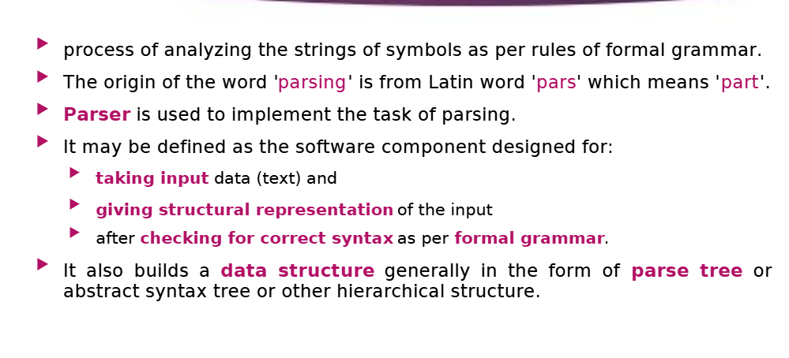
Parsing and Parser

Slide 19
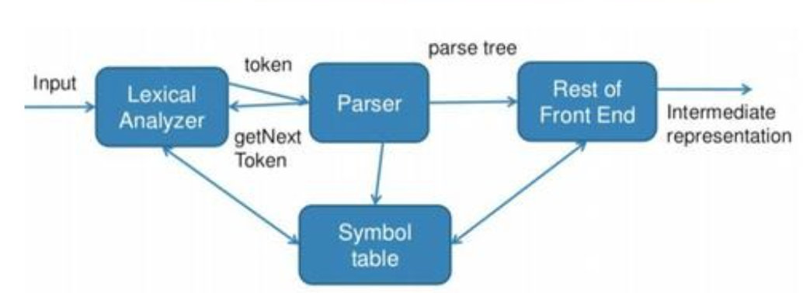
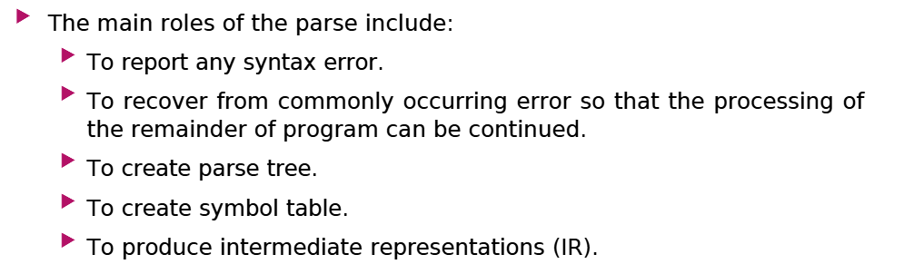

Slide 20
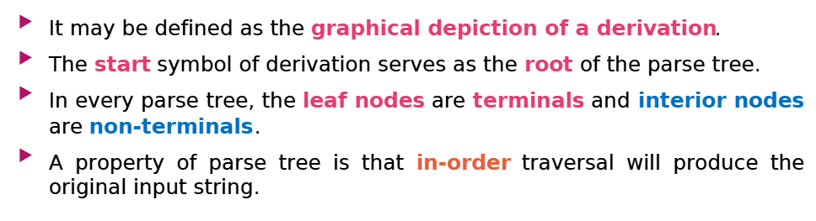
Parse Tree

Slide 21
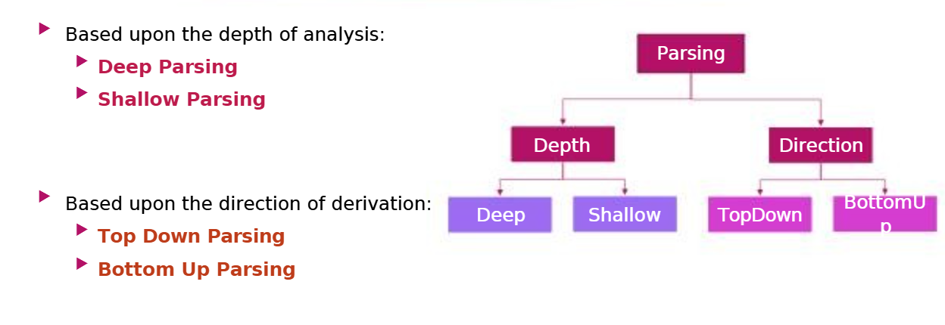

Slide 22
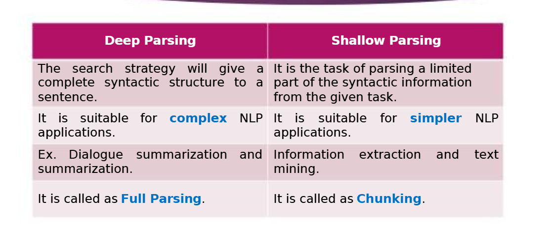

Slide 23
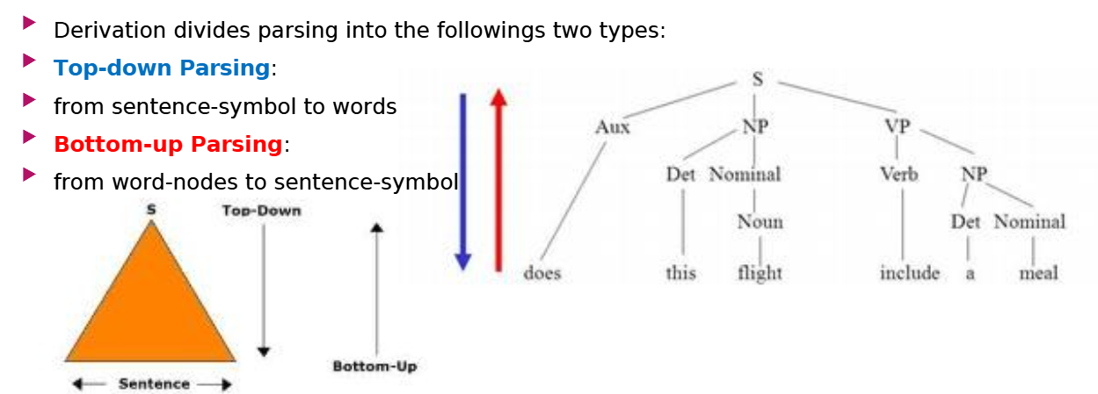
Top down parsing

Slide 24
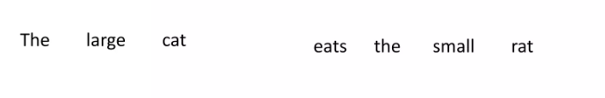
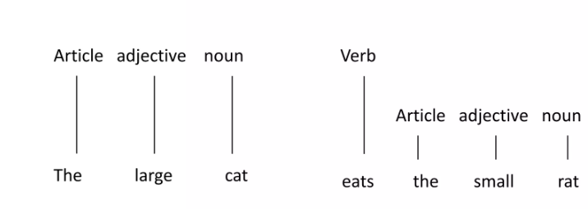
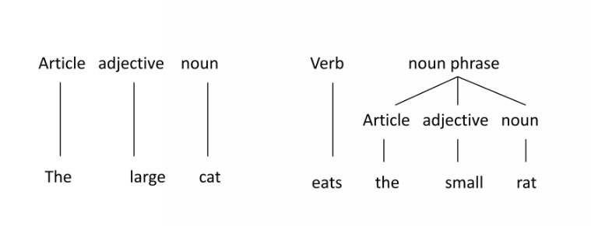

Slide 25
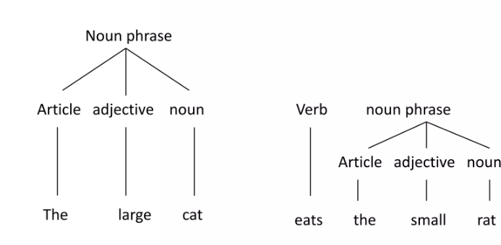
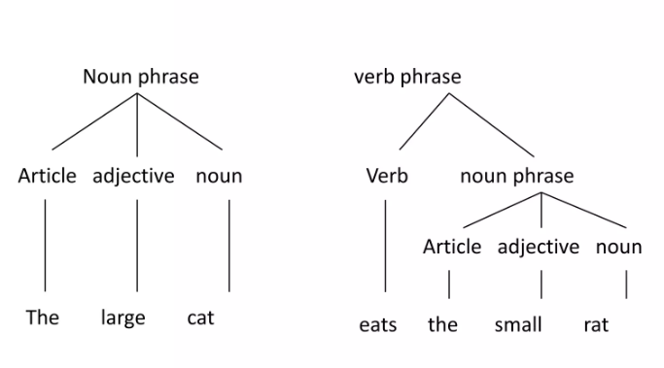

Slide 26
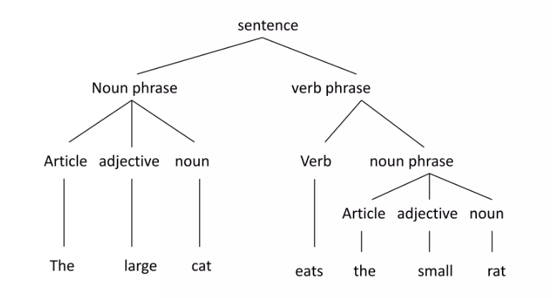

Slide 27
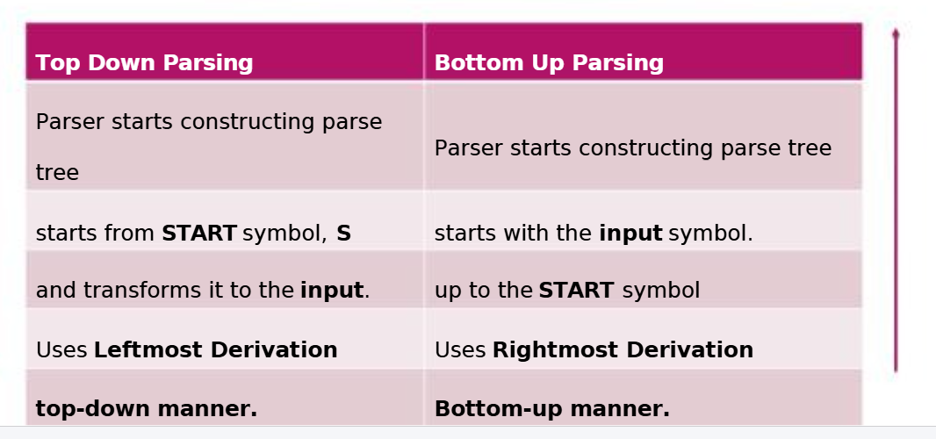

Slide 28
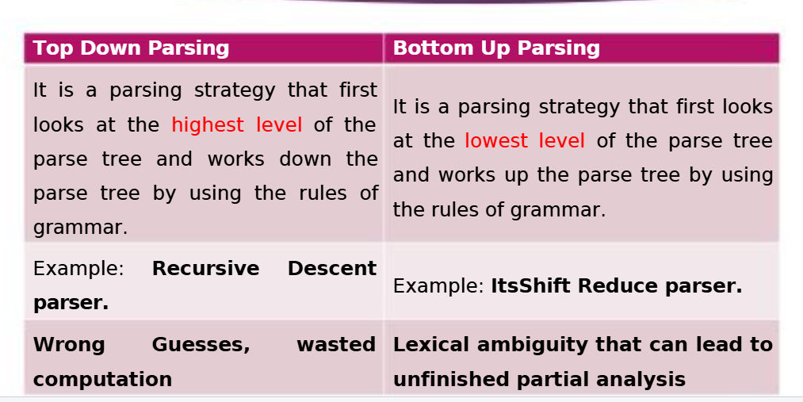

Slide 29
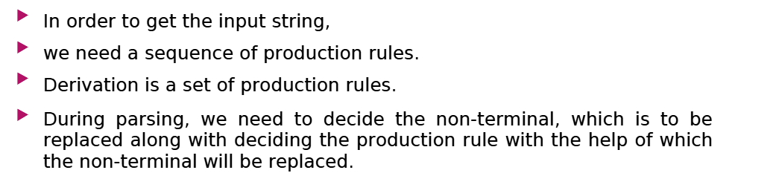
Derivation

Slide 30
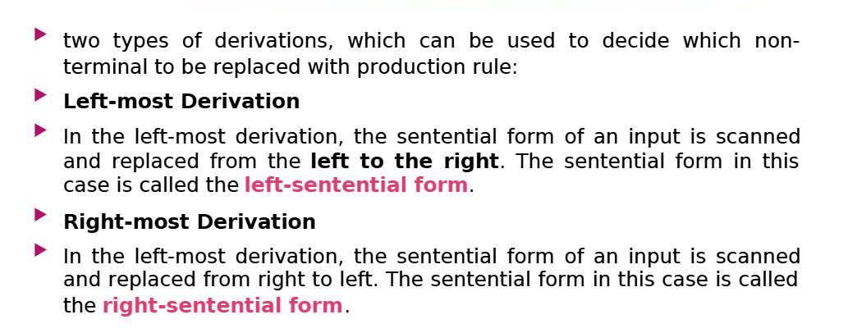
Types of Derivation

Slide 31
Grammar rules of English
Grammar rules define how words and phrases are structured to form meaningful sentences. NLP models rely on these rules for syntactic parsing, machine translation, and information retrieval.
Basic Grammar Rules in NLP
Sentence Structure (S → NP VP)
Example: "The cat sleeps.“
S (Sentence)
├── NP (Noun Phrase) → "The cat"
├── VP (Verb Phrase) → "sleeps"

Slide 32
Part of Speech (POS) Tagging
Identifies each word's grammatical category (noun, verb, adjective, etc.).
The/DT cat/NN sleeps/VBZ .
DT (Determiner): "The“
NN (Noun): "cat“
VBZ (Verb, 3rd person singular): "sleeps“

Slide 33
Word Order (Syntax)
English typically follows Subject-Verb-Object (SVO) order ("She eats apples"). Deviations ("Apples she eats") sound unnatural.
English follows SVO (Subject-Verb-Object) order.
Example: "John reads a book.“
Incorrect: "Reads John a book."

Slide 34
Tense & Agreement
Singular vs. Plural:
"She runs" (Correct) | "She run" (Incorrect)`
Verb Tense: "I eat" (Present) | "I ate" (Past)`
Ambiguity in Grammar
Lexical Ambiguity: "bank" (financial institution vs. riverbank)
Syntactic Ambiguity: "I saw the man with the telescope." (Who has the telescope?)

Slide 35
Treebank
A treebank is a linguistically annotated corpus where sentences are parsed into syntactic trees, representing their grammatical structure. Each word is tagged with its part of speech (POS) and linked to other words in a hierarchical structure. It provides structured information about sentence structure, word relationships, and grammatical functions.
Treebanks are classified into two major types: Constituency Treebanks (Phrase Structure Trees) Dependency Treebanks (Word-to-Word Relationships)

Slide 36
Constituency Treebanks (Phrase Structure Trees)
Constituency Treebanks use phrase structure grammar (CFG - Context-Free Grammar) to represent hierarchical sentence structure.
The sentence is broken into phrases like Noun Phrase (NP) and Verb Phrase (VP).
Example Treebank: Penn Treebank (PTB), Brown Corpus.
Parsing Type: Constituency Parsing (Top-down approach).
Usage in NLP: Syntax parsing, Machine Translation, Text Generation.

Slide 37
Example Sentence: "The cat sleeps.“
(S
(NP (DT The) (NN cat))
(VP (VBZ sleeps)))
S (Sentence)
NP (Noun Phrase) → "The cat“
VP (Verb Phrase) → "sleeps"

Slide 38
Dependency Treebanks
Dependency Treebanks represent sentences as word-to-word dependencies rather than phrase structures.
They directly link words using grammatical relations (e.g., subject, object).
Example Treebank: Universal Dependencies (UD), Prague Dependency Treebank (PDT).
Parsing Type: Dependency Parsing (Graph-based approach).
Usage in NLP: Semantic parsing, Information Extraction, Chatbots.

Slide 39
The cat sleeps on the mat." Dependency Structure Representation:
sleeps
├── cat (nsubj)
│ ├── The (det)
├── on (prep)
├── mat (pobj)
├── the (det)
Root word: "sleeps" (main verb)"cat" depends on "sleeps" as nsubj (subject)."on" (preposition) depends on "sleeps"."mat" (object of preposition) depends on "on".

Slide 40
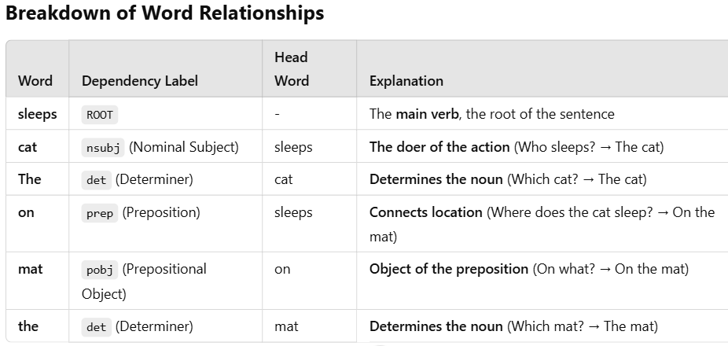

Slide 41
Step-by-Step process of Dependencies
1. Identifying the Root Word
"sleeps" is the main verb (ROOT) of the sentence.
It does not depend on any other word because it's the main action.
2. Identifying the Subject
"cat" is the subject (nsubj) because it performs the action of sleeping.
The subject depends on the verb ("sleeps").
3. Determiners (Articles) Modify Nouns
"The" (det) is a determiner for "cat" → "The cat".
Similarly, "the" (det) is a determiner for "mat" → "The mat".
4. Identifying the Prepositional Phrase
"on" (prep) is a preposition linking "sleeps" to "mat".
"mat" (pobj - prepositional object) is the object of "on" → "on the mat".

Slide 42
Comparison of Treebanks
Feature | Constituency Treebanks | Dependency Treebanks
Structure | Phrase-based Tree | Word-to-Word Relationships
Grammar Type | Context-Free Grammar (CFG) | Dependency Grammar
Parsing Type | Top-down Parsing | Graph-based Parsing
Example Treebanks | Penn Treebank (PTB), Brown Corpus | Universal Dependencies (UD), Prague Dependency Treebank
Best For | Syntax Checking, Grammar Correction | Chatbots, Machine Translation

Slide 43
1. Probabilistic Context-Free Grammar (PCFG)
It’s like a normal grammar, but each rule has a probability. The probabilities tell us how likely a rule is used.
Example PCFG Rules:
Sentence → Noun Phrase + Verb Phrase (1.0)
Noun Phrase → "The cat" (0.6) | "A dog" (0.4)
Verb Phrase → "runs" (0.7) | "sleeps" (0.3)
Generating a Sentence:
"The cat runs" → 1.0×0.6×0.7=0.421.0 \times 0.6 \times 0.7 = 0.421.0×0.6×0.7=0.42 (42% chance)
"A dog sleeps" → 1.0×0.4×0.3=0.121.0 \times 0.4 \times 0.3 = 0.121.0×0.4×0.3=0.12 (12% chance)

Slide 44
2. Probabilistic CYK Algorithm
This is used for parsing (checking if a sentence is valid).
It follows bottom-up parsing, meaning it builds the sentence step by step.
Example: Parsing "The cat sleeps
"Grammar Rules with Probabilities:
NP → "The cat" (0.6) | "A dog" (0.4)
VP → "sleeps" (0.3) | "runs" (0.7)
S → NP VP (1.0)
"The cat" → NP (0.6)"sleeps" → VP (0.3)
"The cat sleeps" → S (0.6 × 0.3 = 0.18)

Slide 45
3. Probabilistic Lexicalized CFG (PLCFRG)
This is a PCFG with word-specific rules. It improves accuracy by considering which words are used together.
Example:
VP[chased] → Verb[chased] NP (0.8)
Verb[chased] → "chased" (1.0)
NP[dog] → "the dog" (0.9)
This tells us "chased" is more likely to be followed by "the dog" rather than "the cat"!

